Slide 1

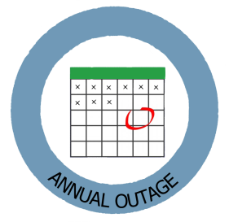
Subject Topic: Outage Database
How We Put the Pieces Together
Shanda Bittick

Slide 2
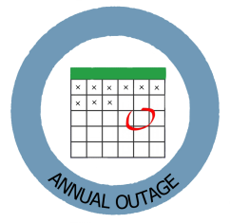

Goals of Discussion Outage Database
Review Annual Outage Database
Task tracker & Templates
Reporting capabilities
Sharepoint Calendar
Demonstration
Opportunities/Next Steps (15 Minutes)

Slide 3
Enterprise Outage
Enterprise Outage is the centralized program for entering and managing facility outage dates. This information is needed for multiple purposes.
Web Application that functions similarly to RI.
Manufacturing Data is shared by all Reliability application – RI, MOC, Outage, MTT (Manufacturing Task Tracker)
Manufacturing data includes Site, Employee, Business Unit/Area, Roles

Slide 4
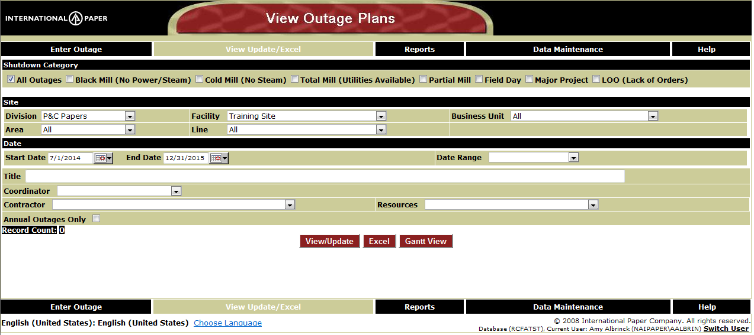
Accessing Outage
Open Internet Explorer
Type OUTAGE or outage.ipaper.com in IE address line

Slide 5
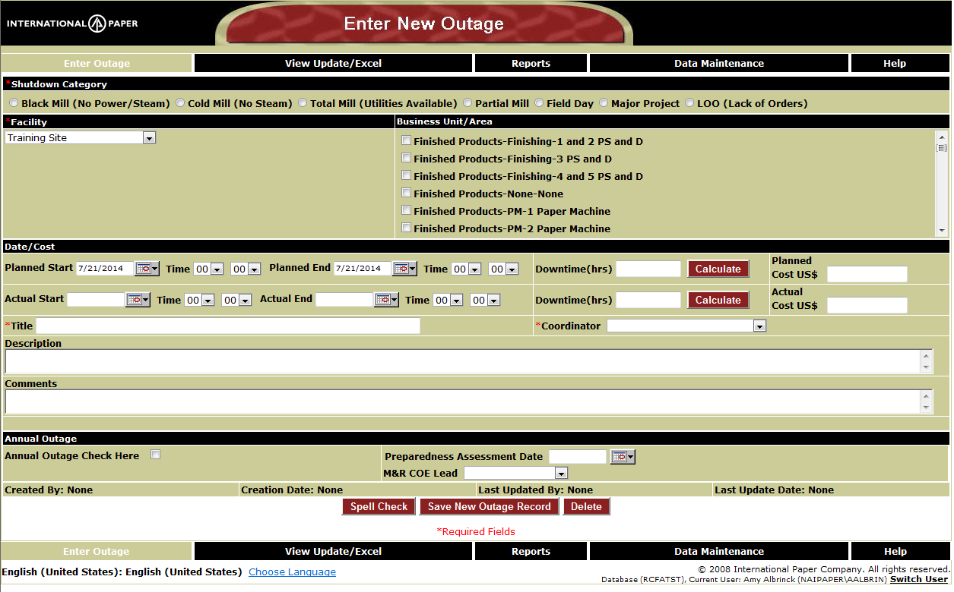
Enter Outage
The required fields are identified with *
Shutdown Category, Facility, Title, Outage Coordinator

Slide 6
View Update/Excel
Search Criteria includes: Shutdown category, Site, Area, Dates,
Title, coordinator, contractor, resources
View/Update – results will appear in table on page
Excel – results will be returned in excel
Gantt View – results will appear in Gantt like display

Slide 7
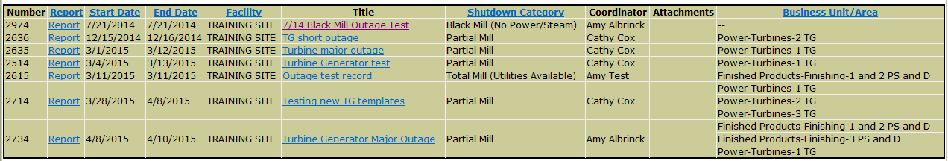
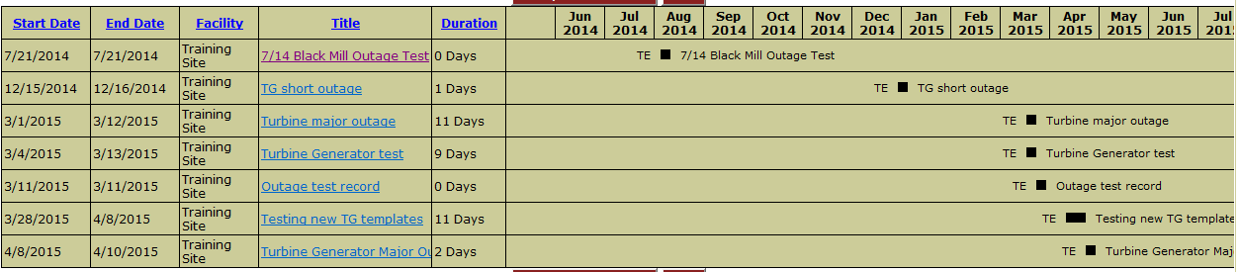
View Update
Select Criteria
Click on or
Click on Title link to update Outage details
Gantt View

Slide 8
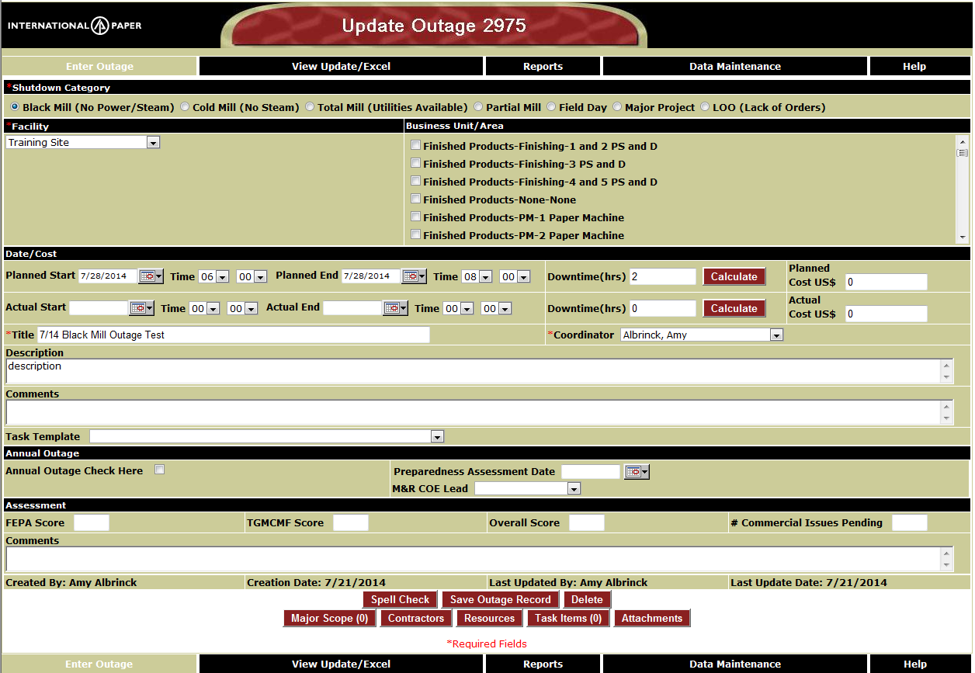
Update Outage

Slide 9
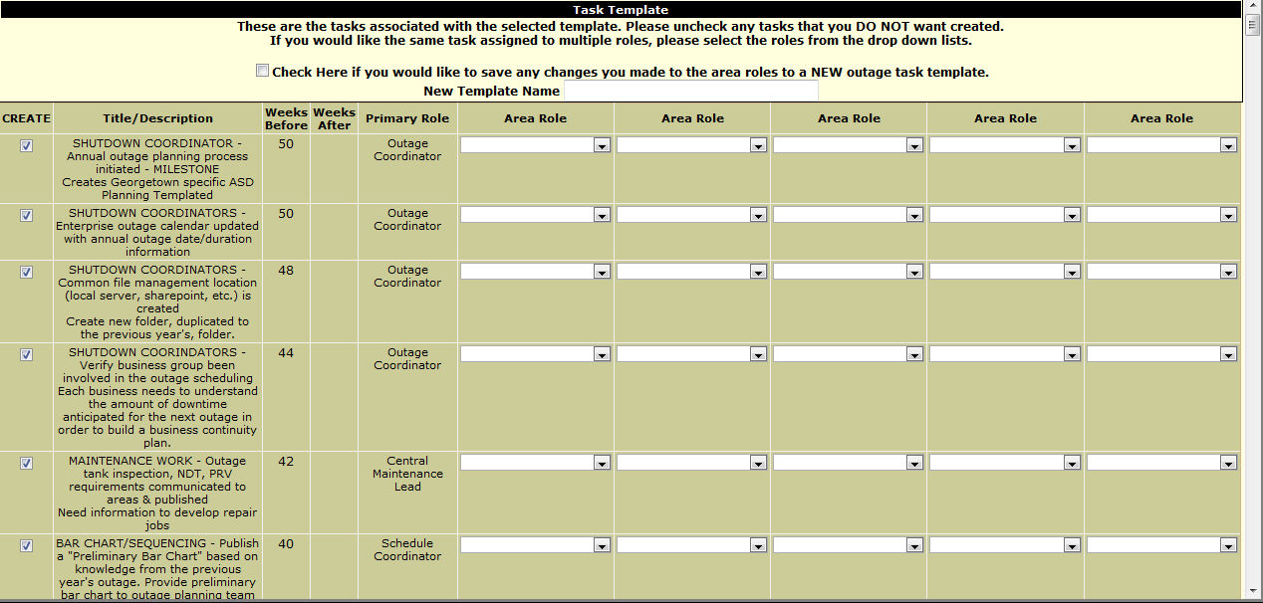
View Task Template
The task template drop down list will show once an outage has been saved.
Click View to see the detail for the template tasks.
All tasks associated with the template selected will be displayed.

Slide 10
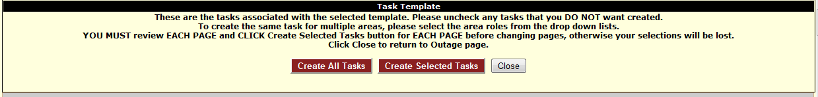

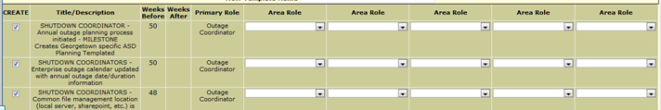
Task Template Selection
This will create all tasks associated with the template. This should be selected if you’ve made no changes to the selected tasks or area roles.
This will create only the tasks that have been checked. By Default, all tasks are selected but you can uncheck any tasks.
If the template has a large number of tasks (>100), there will be multiple pages. BE SURE to click one of the buttons before going to the next page or your selections will be lost.

Slide 11
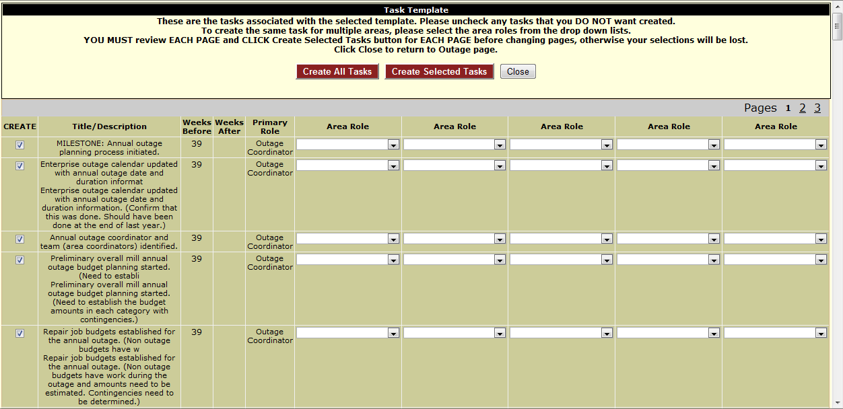
Task Template Selection

Slide 12
Task Template Selection
Create – checkbox to allow you to select/unselect individual tasks
Only those selected will be created
Title/Description
Weeks Before – Task due date will set to the Outage Start Date minus the number of week before
Weeks After – Task due date will be set to the Outage Ends Date plus the number of weeks after
Primary Role – A single task will be created for this role
Area Role(s) – If any area roles are selected, a sub-task will get created with the parent task being the one created for the primary role.

Slide 13
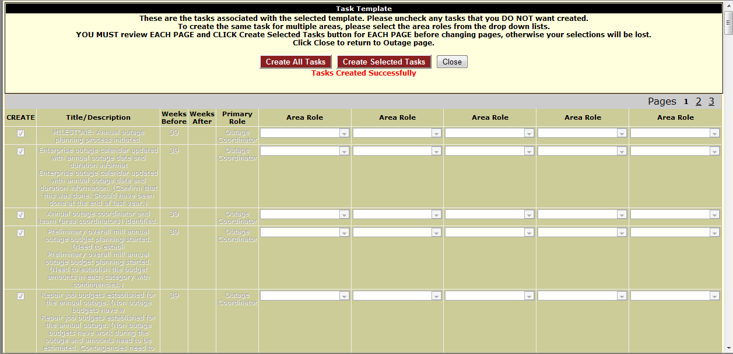
Template Task Selection
Create Selected Tasks
Notice the tasks that were checked are now disabled. This is because they have been created.

Slide 14
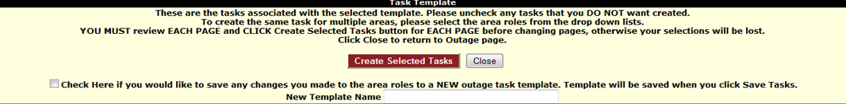
Template Task Selection New Template
Go to Last page of tasks
Check box and new template name
Check the checkbox and enter a name to create a new template.

Slide 15
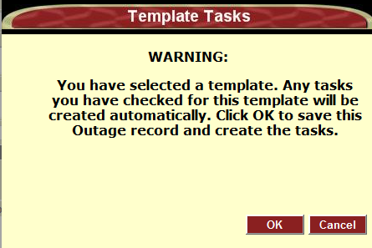
Update Outage Save with template selected
Warning popup will appear letting you know that a template was selected and that the tasks will be created.
OK – Outage saved and tasks created
Cancel – Back to Enter Outage page

Slide 16

Update Outage
The outage record has now been saved
Notice that the task template drop down list can no longer be selected
Number of tasks were created will be displayed
Clicking on Task Items will take you to Task Tracker so you can manage the tasks.

Slide 17
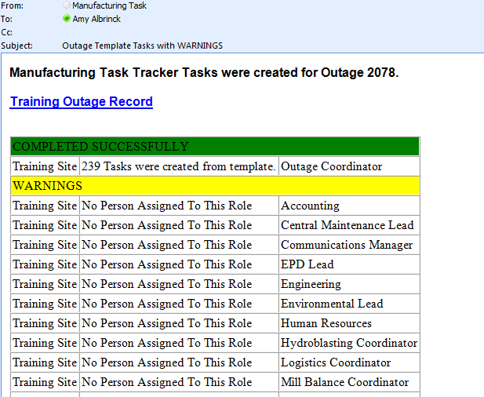
Task Creation
Since templates are created based on roles, some maintenance made need to take place in the event that no one has been assigned to a role that a template task was assigned to.
You will receive an email once you save your outage record, indicating this.
Two approaches to Warnings:
Assign user to the Roles identified as having no one assigned
Change responsible person on the tasks to a specific person rather than a role

Slide 18
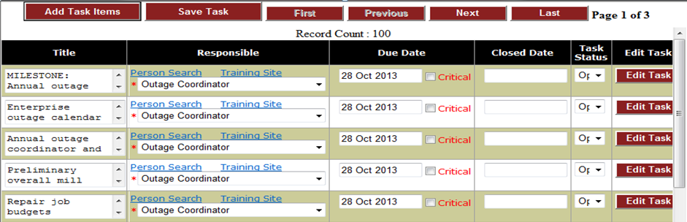
Task Items (Task Tracker)
Click Task Items to access tasks and manage them.

Slide 19
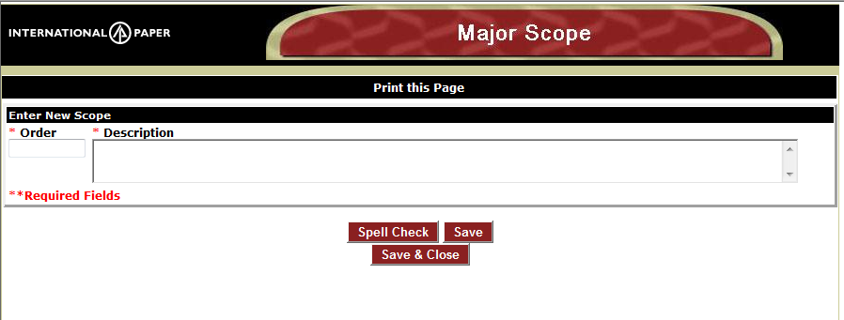
Major Scope
Click Major Scope
Enter order and description
Click Save or Save & Close

Slide 20
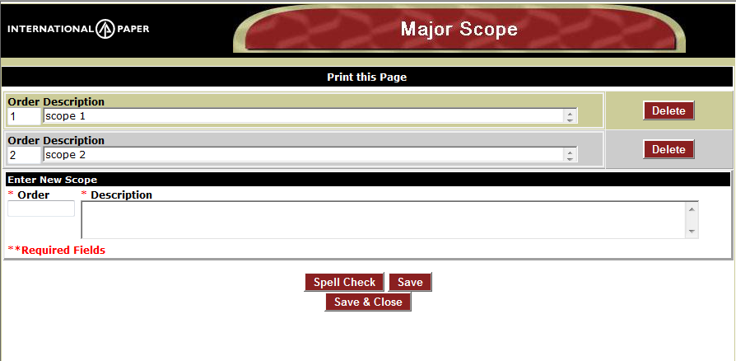
Major Scope
Scope will be added to Outage Record

Slide 21
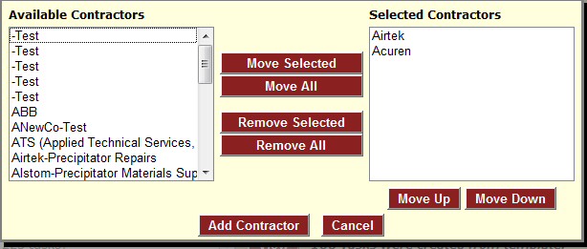
Contractors
Click Contractors button
Select Contractor – (Type of work) and click “Move Selected” or double-click.
You may select multiple or just one at a time
Click Add Contractor
Note: This is not a comprehensive list of contractors. If you would like to add additional names, contact Doug Todd.

Slide 22
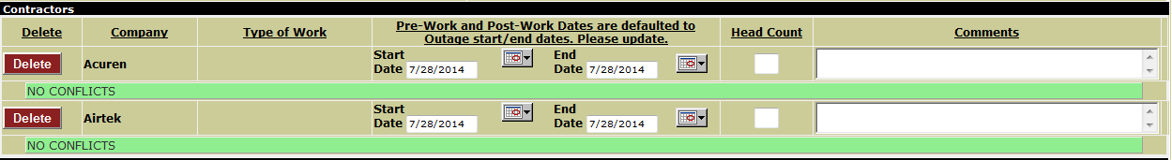
Contractors
Contractors will be added to Outage record.
May enter more details (Pre-work or post-work dates), head count, and comments
REMEMBER to SAVE OUTAGE RECORD
If the contractor has been selected for another outage, a confict will be shown.

Slide 23
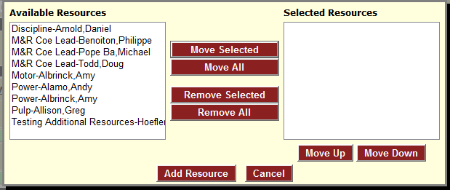
Resources
Click Resources button
Select Resource and click “Move Selected” or double-click.
You may select multiple or just one at a time
Click Add Resource

Slide 24
Resources
Resources will be added to Outage record.
May enter more details - start and end dates and comments
REMEMBER to SAVE OUTAGE RECORD

Slide 25
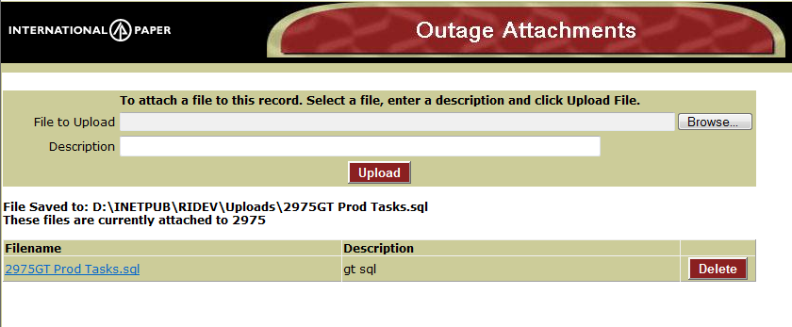
Attachments
Attachments can be added immediately after the initial Outage information is Saved or at later date
Click on Attachments button on bottom of screen
Browse and select file to upload
Enter Description of File
Click Upload

Slide 26
Enterprise Outage Sharepoint
Facility Sharepoint templates automatically replicate site information from Outage Enterprise Database to Facility Sharepoint calendar.
The facility Sharepoint calendar is located under the Maintenance Department site and named Outage Calendar.
Example Ticonderoga → http://spapp01.ipaper.com/sites/Ticonderoga/Maint/Lists/Outage/AllItems.aspx

Slide 27
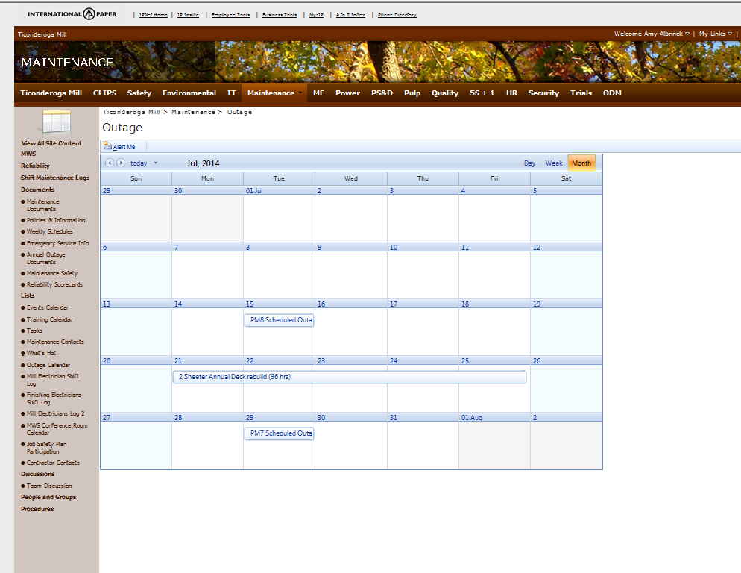
Sharepoint Example

Slide 28
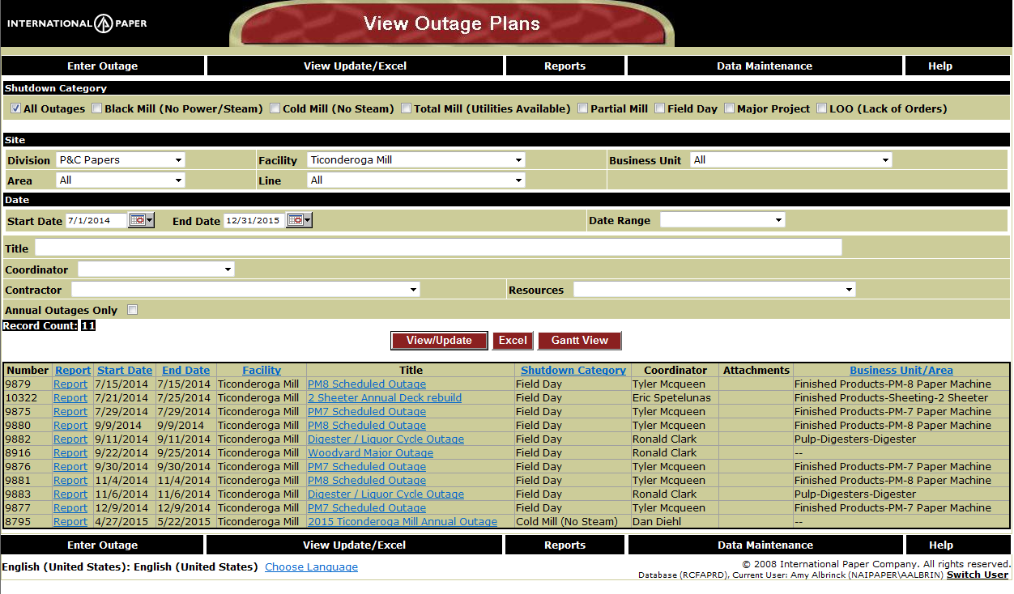
Sharepoint Example
Notice the Outage records for July

Slide 29
Reports
Annual Completeness Scorecard
Annual Preparedness Meeting Schedule
Business Outlook
Contractor Conflict
Outage Gantt Chart
Outages With No Contractors Assigned
Task Item Listing
Turbine Generator Scorecard

Slide 30
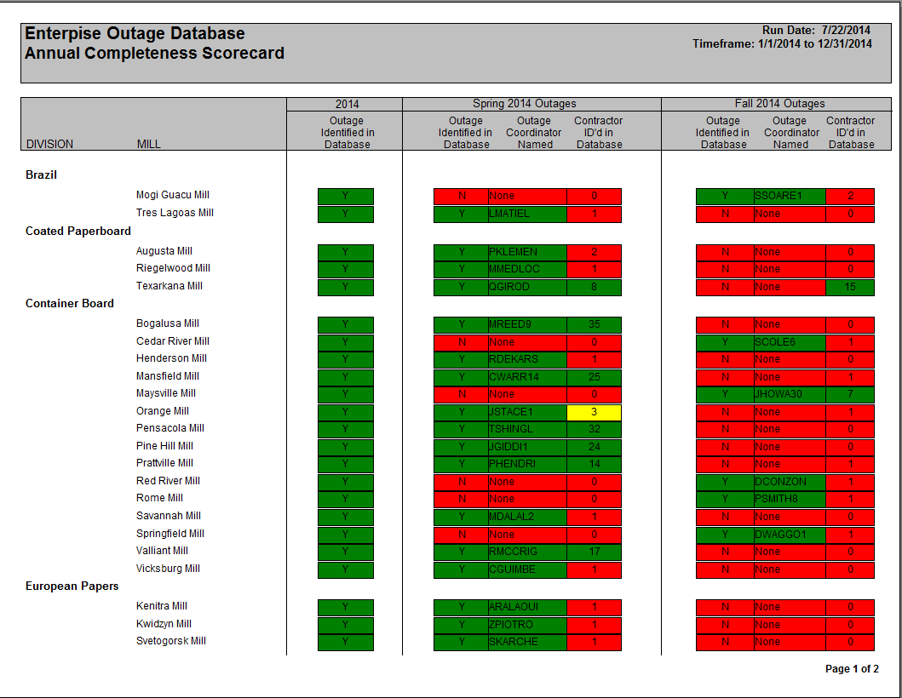
Annual Completeness Scorecard
Search Criteria (date range)

Slide 31
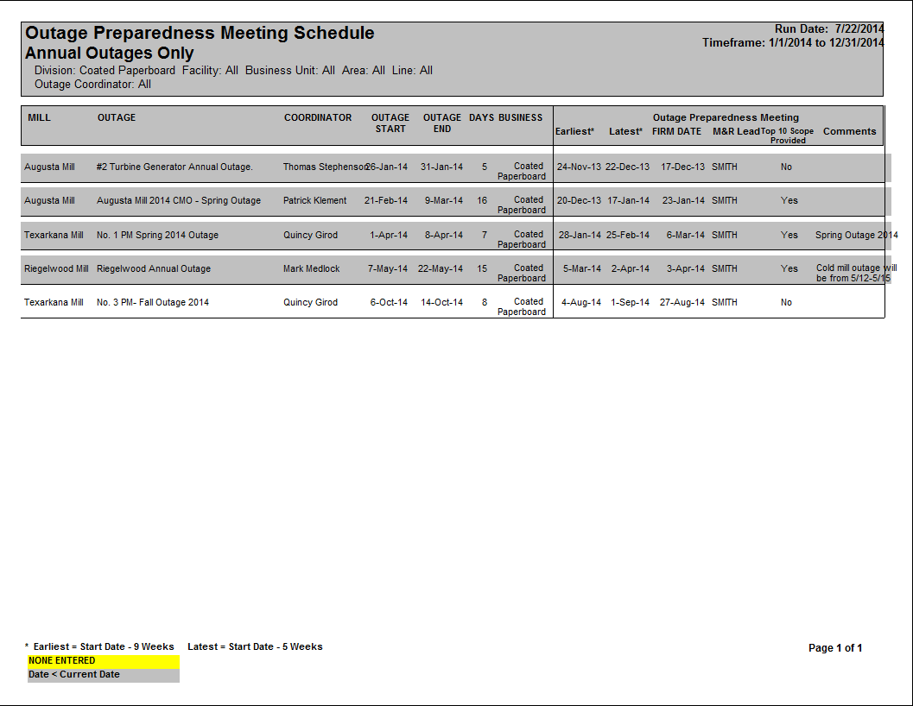
Annual Preparedness Meeting Schedule
Search Criteria (Site, Date Range, Coordinator)
Only shows Annual Outages

Slide 32
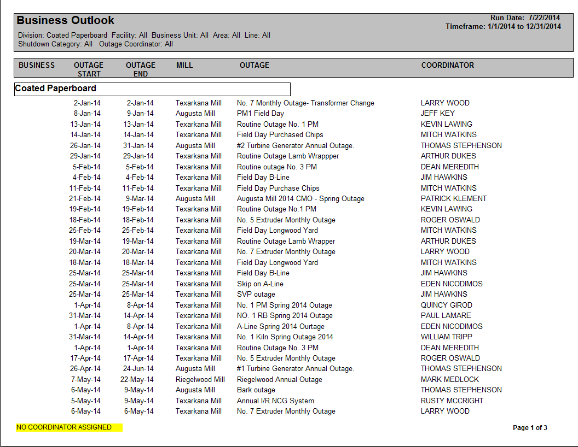
Business Outlook
Search Criteria (Category, Site, Date Range, Coordinator)

Slide 33
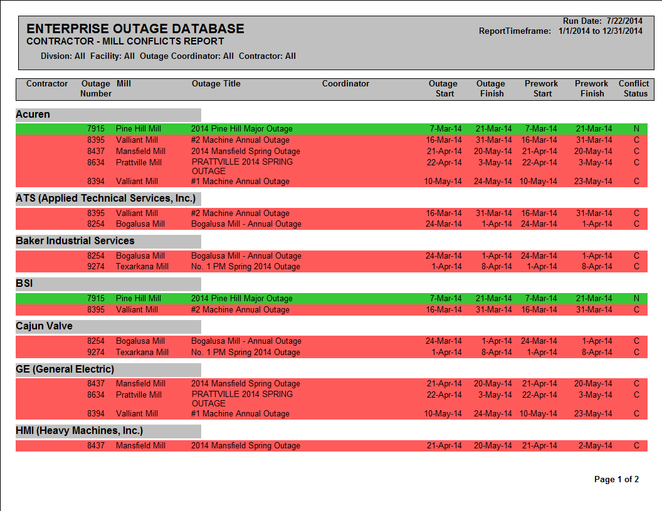
Contractor Conflict
Search Criteria (Category, Site, Date Range, Coordinator, Contractor)

Slide 34
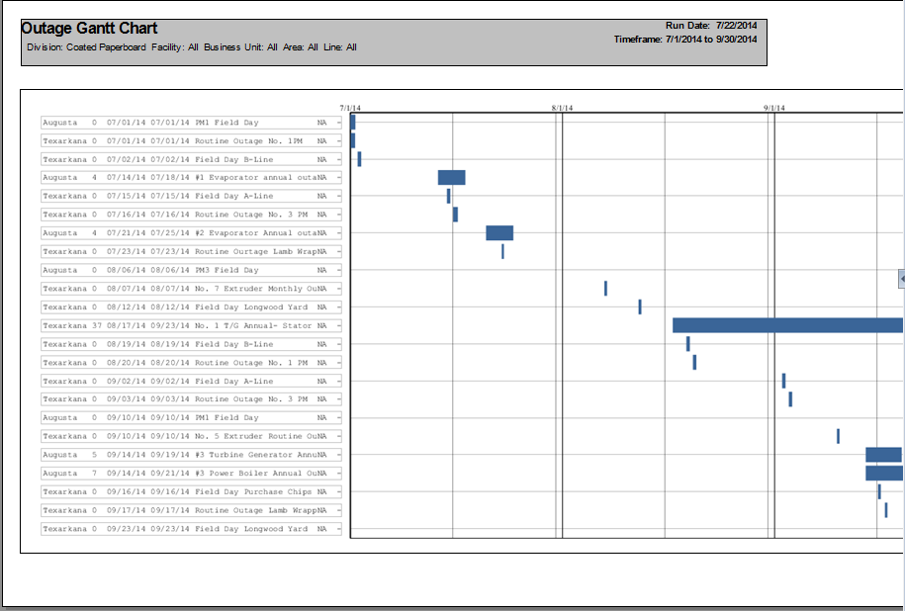
Outage Gantt Chart
Search Criteria (Site, Date Range)

Slide 35
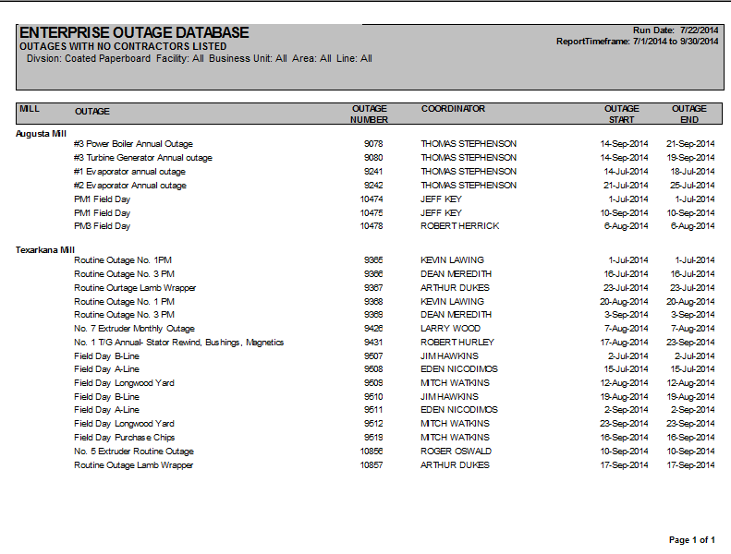
Outages With No Contractors Assigned
Search Criteria (Site, Date Range)

Slide 36
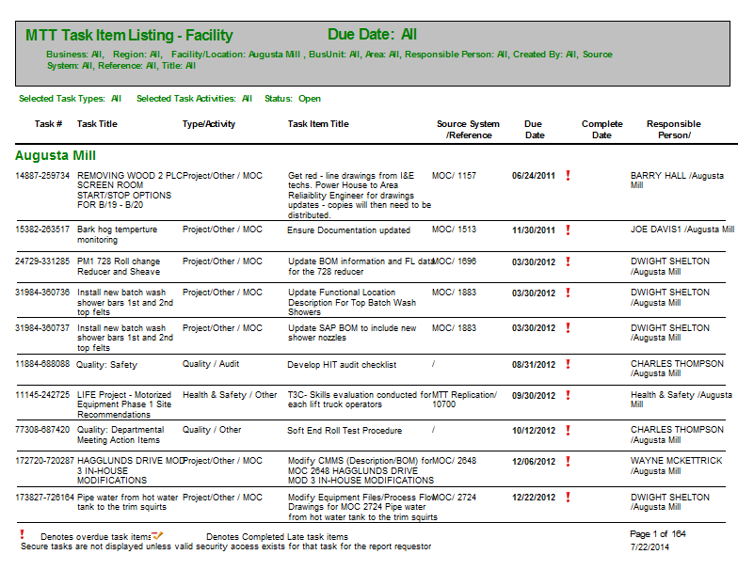
Task Item Listing

Slide 37
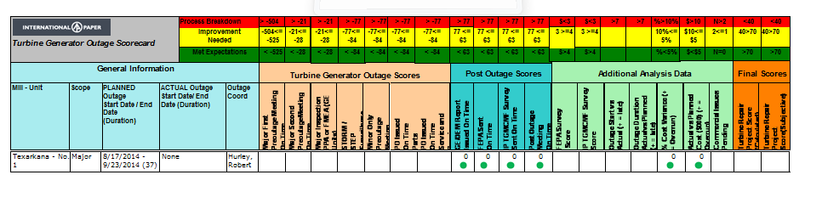
Turbine Generator Scorecard
Search Criteria (Site, Date Range, Outage Number)

Slide 38
Data Maintenance
Resources
Outage Templates

Slide 39
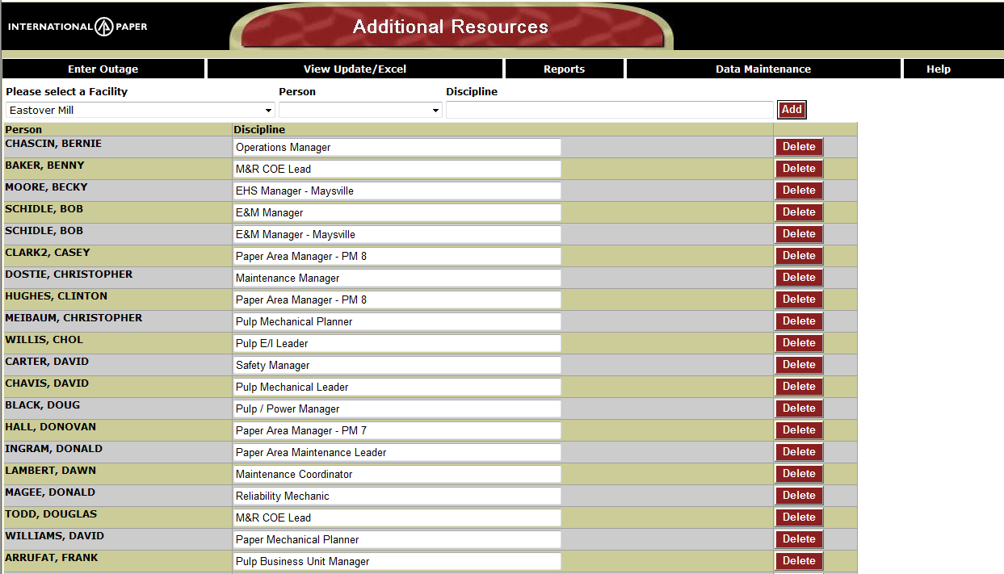
Resource Maintenance
Resources are enterprise wide not site specific
Can add anyone with a discipline

Slide 40
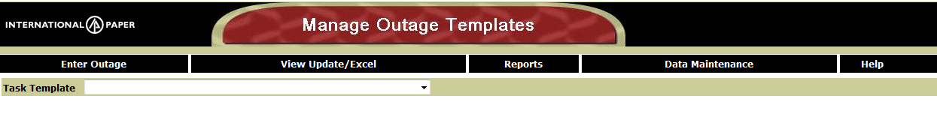
Outage Template
Select template you want to update

Slide 41
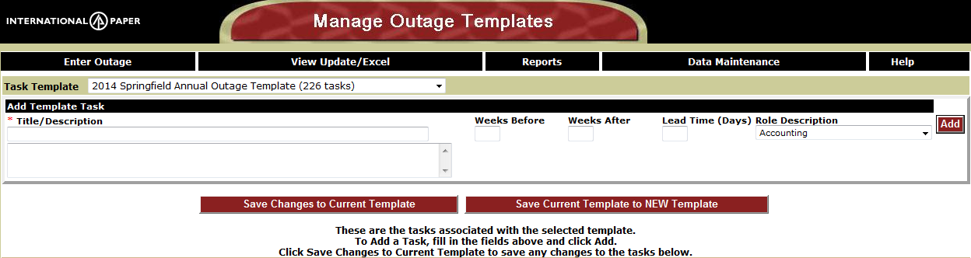
Outage Template
All Tasks will be displayed
Add new task by entering fields and clicking Add
Click Save Changes to Current Template if you’ve made any changes to the tasks in the list
Click Save Current Template to NEW template if you want to create a new template. You will be prompted for a new template name.

Slide 42
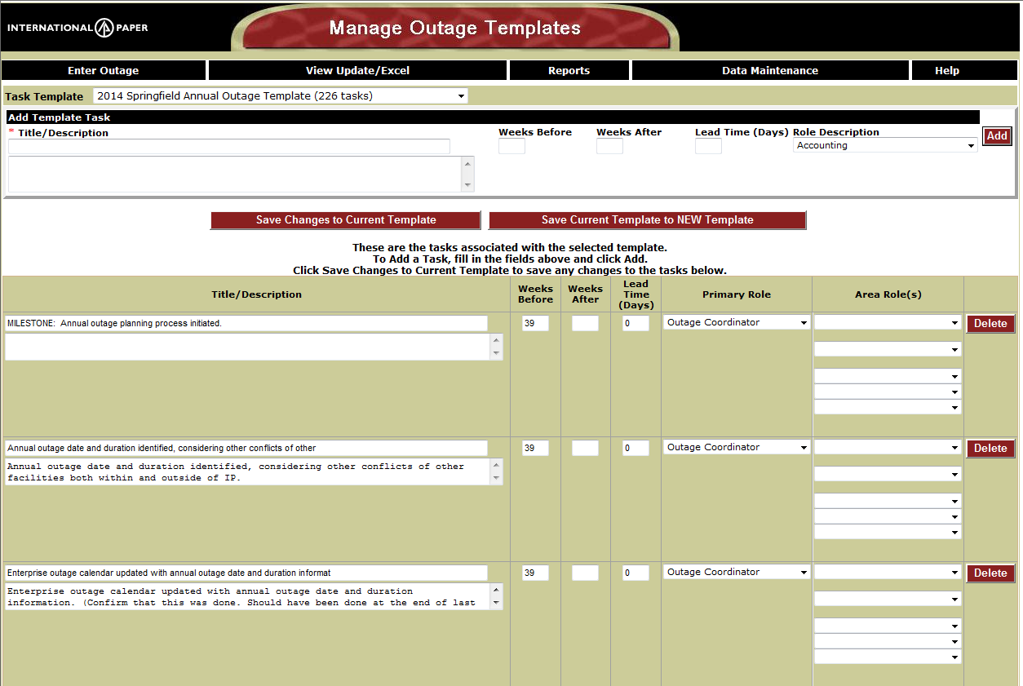
Outage Template
Title, weeks before, weeks after, lead time, primary role and area roles can be updated.

Slide 43
Opportunities Outage Database Presentation

